Slide 1


Data Analysis

Slide 2


Today's agenda
1) Project recap
2) Problem
3) The Analytics team
4) Process
5) Insights
6) Summary

Slide 3

Social Buzz is a fastest growing technology
unicorn that need to adapt quickly to its global
scale.
Project Recap
Accenture has begun 3 month POC
focusing on these tasks:
An audit on their big data.
Recommendations for an successful IPO.
An analysis to find Social Buzz’s top 5 most
popular categories of content.

Slide 4


Problem
Over 1,00,000 posts per day.
36,500,000 (36.5M) annual posts.
Identify top 5 categories with largest
aggregate popularity.

Slide 5



Andrew Fleming
Chief Technology Architect
The Analytics team
Marcus Rompton
Senior Principal
Parv Kaul
Data Analyst

Slide 6
Requirements Gathering
Process
1
Data Collection + Understanding
2
Data Cleanup + Modeling
3
Data Analysis
4
Insights Generation
5

Slide 7

Insights
1897
January
16
Reaction to
Month with most
Unique Categories
Animal Posts
posts

Slide 9
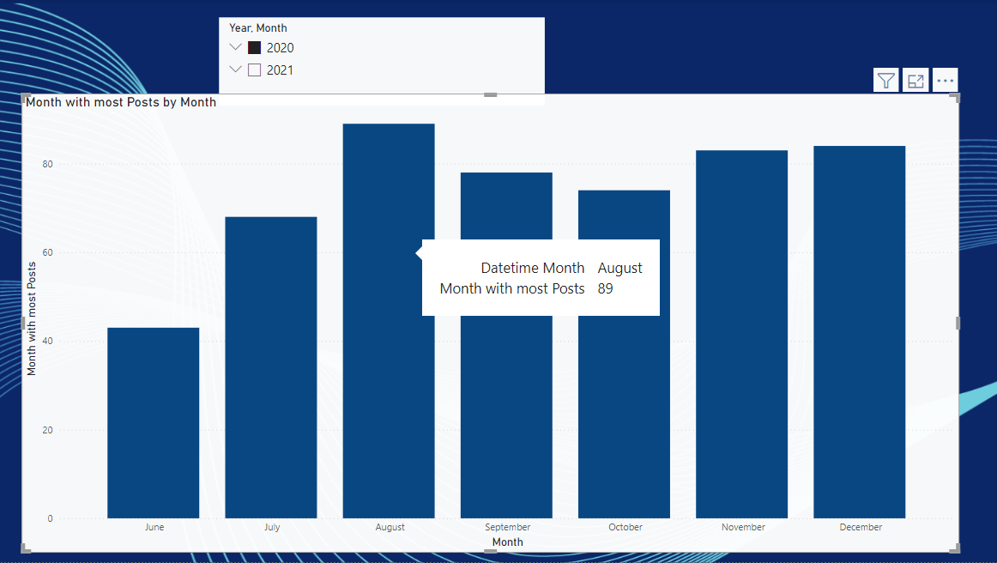

Slide 10
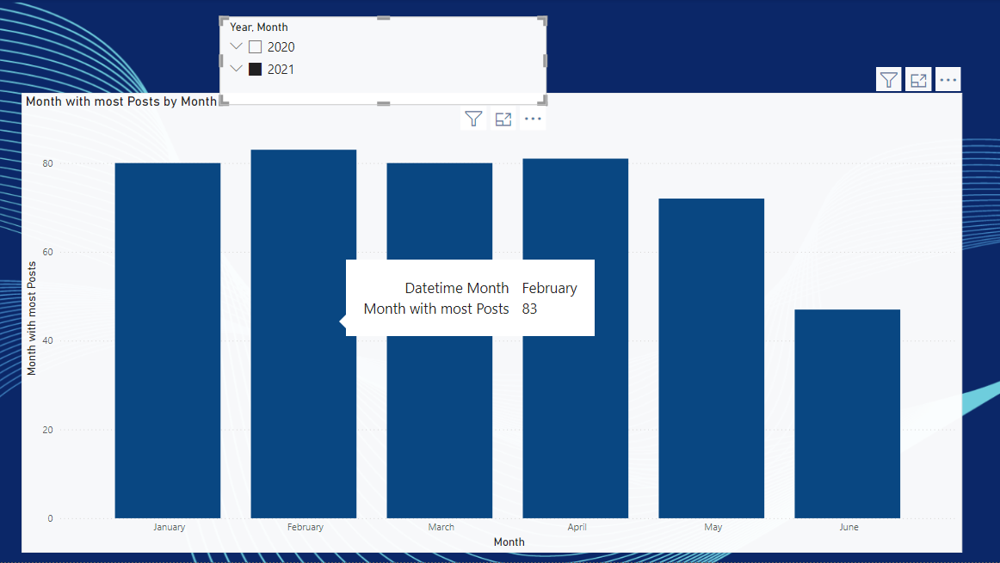

Slide 12

ANALYSIS
Science and Technology are the most popular categories of content showing that people enjoy “real-life” and “factual” content the most.
INSIGHT
Food is a common theme with the top 5 Categories with “Science” ranking the highest. This may give an indication to the audience within your user base. You could use the insight to create a campaign and work with healthy eating brands to boots user engagement.
Summary
NEXT STEPS
This ad-hoc analysis is insightful, but it’s time to take this analysis into large scale production for real-time understanding of your business. We can show you how to do this.

Slide 13

Thank you!
ANY QUESTIONS?

